Slide 1
MESH CURRENT ANALYSIS METHOD
MESH CURRENT ANALYSIS METHOD
1. Define each mesh current consistently. Unknown mesh currents will be always defined in the clockwise direction; known mesh currents (i.e., when a current source is present) will always be defined in the direction of the current source.
2. In a circuit with n meshes and m current sources, n − m independent equations will result. The unknown mesh currents are the n − m independent variables.
3. Apply KVL to each mesh containing an unknown mesh current, expressing each voltage in terms of one or more mesh currents.
4. Solve the linear system of n − m unknowns.

Slide 2
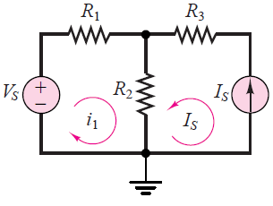
Mesh Current Method
It is natural to also encounter circuits containing current sources, in practice.
The following circuit illustrates how mesh analysis is applied to a circuit containing current sources.

Slide 3
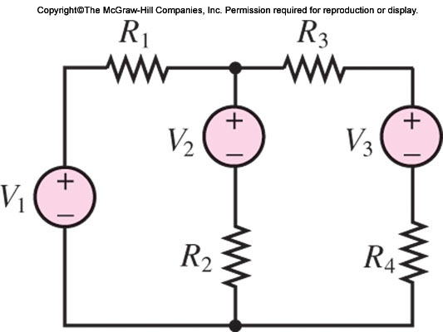
Mesh Current Method
The following circuit illustrates how mesh analysis is applied to a circuit containing current sources.

Slide 4
Mesh Analysis with Current Sources
MESH CURRENT ANALYSIS METHOD
1. Define each mesh current consistently. Unknown mesh currents will be always defined in the clockwise direction; known mesh currents (i.e., when a current source is present) will always be defined in the direction of the current source.
2. In a circuit with n meshes and m current sources, n − m independent equations will result. The unknown mesh currents are the n − m independent variables.
3. Apply KVL to each mesh containing an unknown mesh current, expressing each voltage in terms of one or more mesh currents.
4. Solve the linear system of n − m unknowns.

Slide 5
Mesh Current Method
Subsequent application of Kirchhoff’s voltage law (KVL) around each MESH provides the desired system of equations.
In the mesh current method, a current flowing through a resistor in a specified direction defines the polarity of the voltage across the resistor

Slide 6
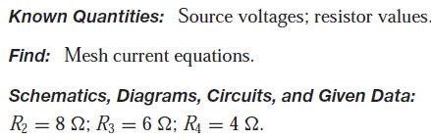

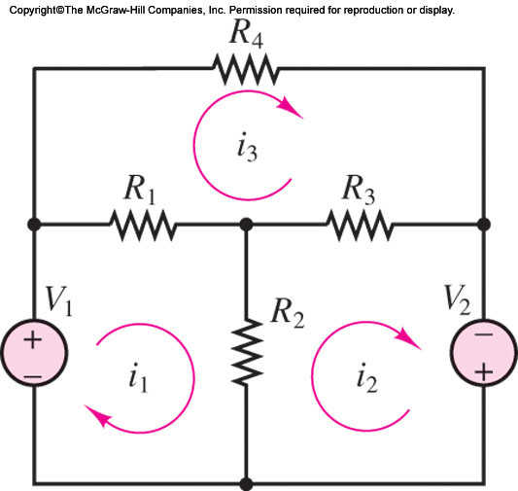
Mesh Current Method : Examples
Write the mesh current equations for the circuit

Slide 7
Mesh Current Method : Examples
MESH CURRENT ANALYSIS METHOD
1. Define each mesh current consistently. Unknown mesh currents will be always defined in the clockwise direction; known mesh currents (i.e., when a current source is present) will always be defined in the direction of the current source.
2. In a circuit with n meshes and m current sources, n − m independent equations will result. The unknown mesh currents are the n − m independent variables.
3. Apply KVL to each mesh containing an unknown mesh current, expressing each voltage in terms of one or more mesh currents.
4. Solve the linear system of n − m unknowns.

Slide 8
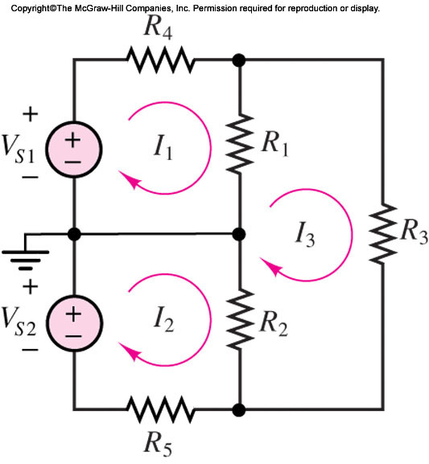
Mesh Current Method : Examples
Write the mesh current equations for the circuit

Slide 9
Mesh Current Method : Examples
A simplified DC circuit model of a three-wire electrical distribution service to residential and commercial buildings.
The two ideal sources and the resistances R4 and R5 represent the equivalent circuit of the distribution system;
R1 and R2 represent 110-V lighting and utility loads of 800 and 300 W, respectively. Resistance R3 represents a 220-V heating load of about 3 kW. Determine the voltages across the three loads.

Slide 10

Mesh Current Method : Examples

Slide 11
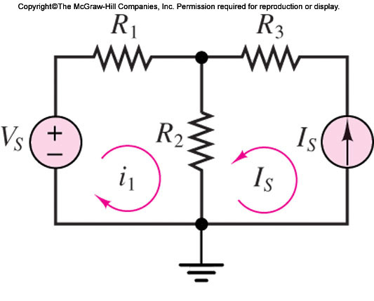
Mesh Current Method : Examples
Mesh Analysis with Current Sources
Current Sources

Slide 12
Mesh Current Method : Examples
The circuit in the figure illustrates how mesh analysis is applied to a circuit containing current sources.
Follow the Steps

Slide 13
Mesh Current Method : Examples
Step 1: Define each mesh current consistently. Unknown mesh currents are always defined in the clockwise direction; known mesh currents (i.e., when a current source is present) are always defined in the direction of the current source.
The mesh currents are shown in Figure. Note that since a current source defines the current in mesh 2, this (known) mesh current is in the counterclockwise direction.

Slide 14
Mesh Current Method : Examples
Step 2: In a circuit with n meshes and m current sources, n − m independent equations will result. The unknown mesh currents are the n − m independent variables.
In this illustration, the presence of the current source has significantly simplified the problem: There is only one unknown mesh current, and it is i1.

Slide 15
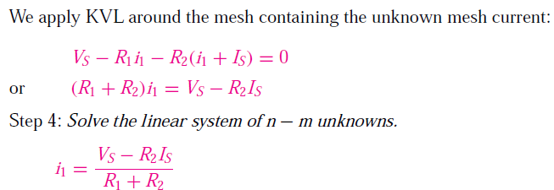
Mesh Current Method : Examples
Step 3: Apply KVL to each mesh containing an unknown mesh current, expressing each voltage in terms of one or more mesh currents.

Slide 16
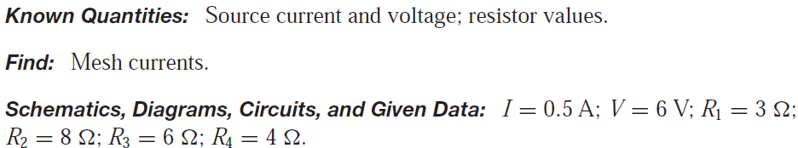
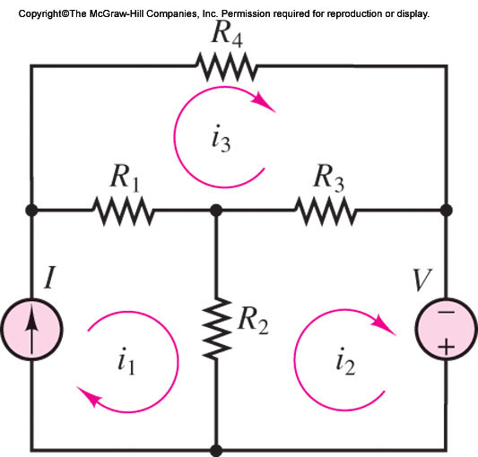
Mesh Analysis with Current Sources Problem
Mesh Analysis with Current Sources Problem

Slide 17

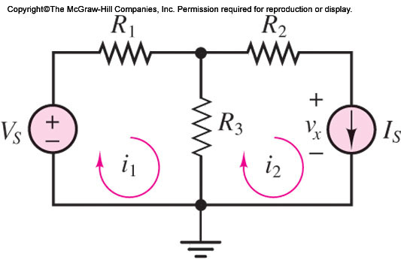
MESH CURRENT ANALYSIS METHOD - Examples
Mesh Analysis with Current Sources

Slide 18
MESH CURRENT ANALYSIS METHOD - Exercise

Slide 19
NODE and MESH ANALYSIS with CONTROLLED SOURCES
The methods just described also apply, with relatively minor modifications, in the presence of dependent (controlled) sources.
Solution methods that allow for the presence of controlled sources are particularly useful in the study of transistor amplifiers…

Slide 20
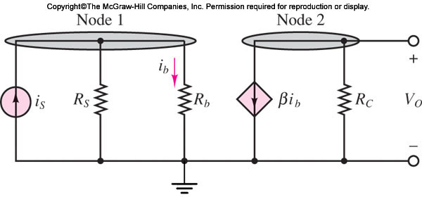
NODE and MESH ANALYSIS with CONTROLLED SOURCES
Here is a simplified model of a bipolar transistor amplifier
Two nodes are easily recognized, and therefore node analysis is chosen as the preferred method

Slide 21

NODE and MESH ANALYSIS with CONTROLLED SOURCES
Applying KCL at node 1, we obtain the following
equation:

Slide 22

NODE and MESH ANALYSIS with CONTROLLED SOURCES
Applying KCL at node 2, we obtain the following
equation:

Slide 23

NODE and MESH ANALYSIS with CONTROLLED SOURCES
Next, observe that current ib can be determined by means of a simple current divider:

Slide 24
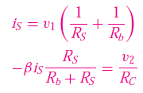
NODE and MESH ANALYSIS with CONTROLLED SOURCES
This is the constraint equation, which when inserted in equation, yields a system
of two equations:
which can be used to solve for v1 and v2. Note that, in this particular case, the two
equations are independent of each other.

Slide 25
Mesh Current Method
The following circuit illustrates how mesh analysis is applied to a circuit containing current sources.

Slide 26
References
Giorgio Rizzoni, “Fundamentals of Electrical Engineering”, McGraw- Hill Education, 2009. ISBN. 978-0-07-338037-7
Peyton Z. Peebles (Author), Tayeb A. Giuma, Principles of Electrical Engineering (Mcgraw Hill Series in Electrical and Computer Engineering), Mcgraw-Hill College, 1991.
Allan R. Hambley, Electrical Engineering: Principles and Applications, Prentice Hall, ISBN-0132130068, 9780132130066, 2011.

